Slide 1
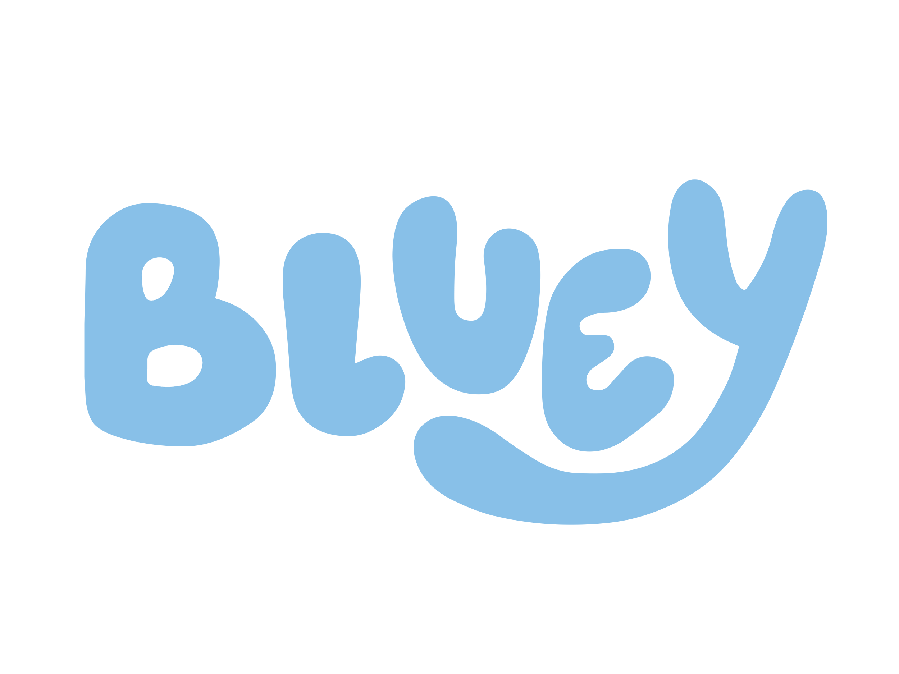
Collaboration Proposal
×
Unlocking Opportunities with Rusty
by Vivi Gao
Jan 2025

Slide 2
Challenges & Opportunities
Current Challenges
1. Approaches to the target audience remains narrow: restrained to school and local regions.
2.Need of a ripe and impactful story to engage with family in military backgrounds, particularly children.
3.Lack audience-tailored approach to deliver more impactful messages.
Opportunities brought
1. Expanded Reach: Bluey’s educational cartoon format can broaden NSI’s influence, connecting with children worldwide, including military and non-military families.
2. Resonant Story: Bluey’s simple yet powerful story, especially through Rusty, a military child, aligns with NSI’s mission and creates an opportunity to connect with military families.
3. Tailored Approach: Bluey’s appeal to children complements our art and creative competitions, offering effective methods to engage and raise awareness about military families.
Notes:
1. Lack of approach add-on: Its reach to families in non-military backgrounds further raises awareness

Slide 3
Exploring Opportunities Together
Key Benefits For NSI:
1. Brand Identity: Aligning with Rusty’s story of resilience and creativity to build a relatable and inspiring image.
2. Brand Positioning: Strengthening NSI’s position as a leading advocate for military children’s voices.
3. Brand Association: Creating a memorable connection with Bluey, a globally recognized brand, enhancing public awareness.
4. Brand Personality: Infusing NSI with traits like warmth, resilience, and inclusivity, reflecting Rusty’s character.
5. Brand Reach: Leveraging Bluey’s wider appeal to reach not only children but also adults, extending the charity’s message.
6. Emotional Resonance: Integrating Rusty’s story into NSI’s mission to foster deeper emotional connections.
7. Stronger Connections: Enhancing emotional ties with military families by showcasing shared values.
*Bluey is not just a children’s animation—it provides comfort and inspiration to many adults and parents, offering a broad audience base.

Slide 4
For Bluey
Key Benefits For Bluey:
1. Reinforcing Bluey’s connection with real world scenarios and situationCollaboration with NPO and charity brings higher reputation and social recognition in overseas region.
2. Strengthening connections with children, promoting the cartoon.Future activities and workshops as a free promotion/advertisement in the UK.
3. Social Impact: Highlighting Bluey’s commitment to inclusivity and supporting diverse family narratives.
4. Character Development: Deepening Rusty’s storyline with real-world connections and social relevance.
5. Educational Value: Positioning Bluey as a platform for promoting empathy and understanding among families.
6. Goodwill: Strengthening Bluey’s reputation as a socially responsible and beloved brand.

Slide 5
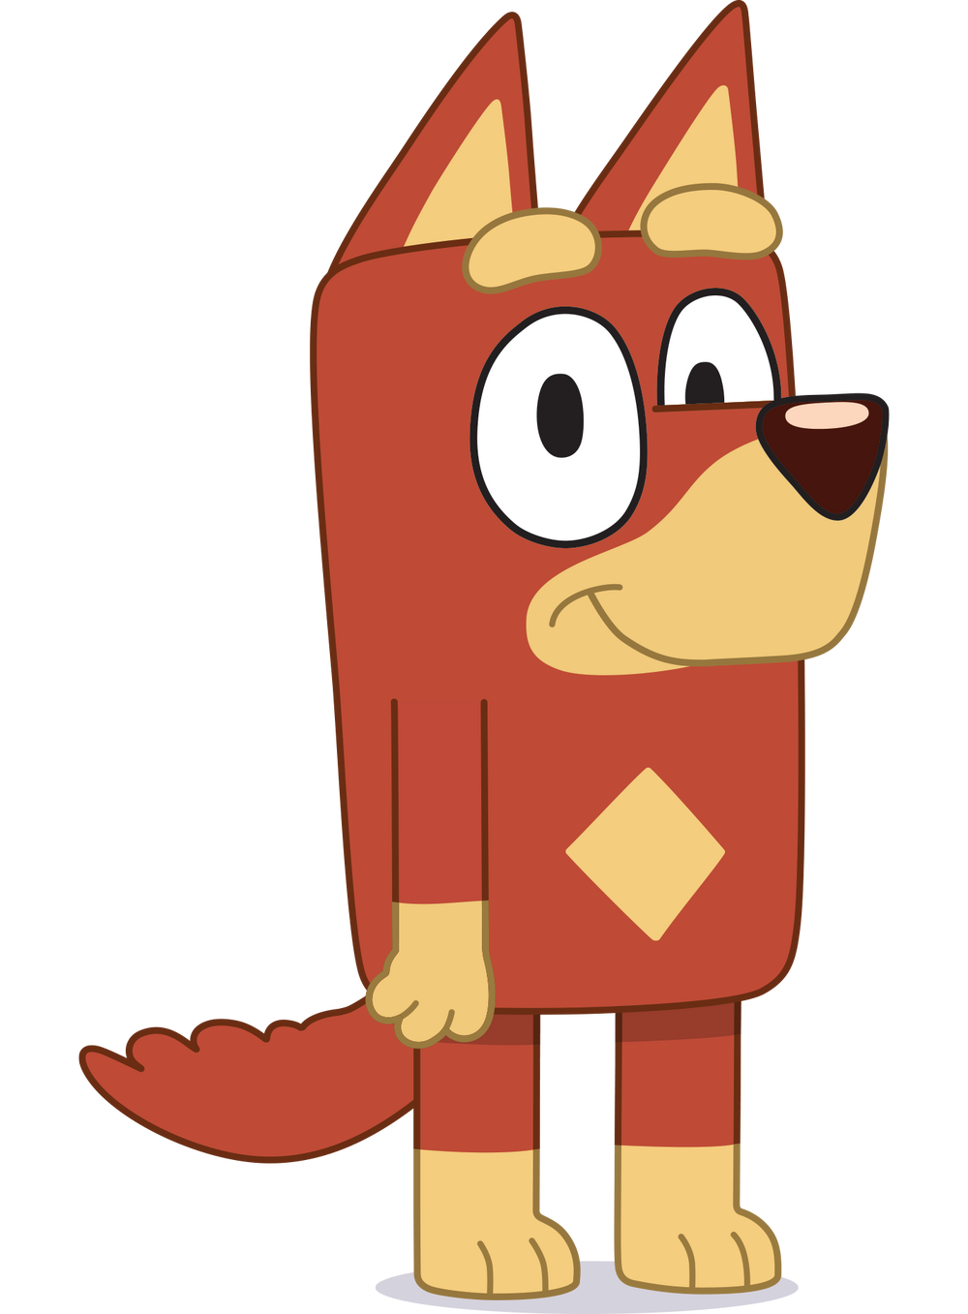
Who&Why Rusty? -Rusty’s Story and Impact
Rusty, a military child from Bluey, aligns strongly with our mission.
Rusty’s Introduction:
Rusty is a young boy with a strong character and a passion for sports. He is the middle child in the family. His father is a soldier and is often away on missions, so Rusty has been influenced by military culture since childhood. He enjoys military-themed games and sharing what he learns. His passion for cricket drives him to practice tirelessly, overcoming challenges like fast bowling, and excelling in sports. Eventually, he becomes a professional cricket player, representing Australia national team. Rusty’s story is one of resilience, growth, and pursues of dreams, inspiring those around him.
Key Points:
Military family background mirrors the experiences of children that we support.
Emotional connection: Rusty’s story inspires resilience and creativity.
Bluey’s popularity ensures wide reach and engagement.
Suggested Episodes to Watch: S02E16 - Army, S03E47 - Cricket
Detailed Introduction Links for Further Exploration: https://www.bluey.tv/characters/rusty/

Slide 6
Collaboration Concept
Social media campaigns sharing stories of military children.
Designating Rusty as the virtual ambassador for Military Child Month.
Co-branded educational resources or workshops.
Joint art or creative competitions themed around Rusty.
More to be added...

Slide 7
Long-term Benefits and opportunities
Testing our ability to set up larger-scaled collaboration and activities. Enriching our activities type.
Future workshop, activity and opportunities in Australia and more, expanding influences beyond UK to potential more Commonwealth countries.
Setting examples for future international collaboration.
Enhancing the social-media outreach and effectiveness.
More to be added...

Slide 8
Exploring the Path Forward
Next steps:
1. Internal Discussions: Specify the proposal scope and goals for NSI.
2. Initial Outreach: Identify and reach out to key contacts within Bluey’s team to gauge interest.
3. Collaborative Planning: Outlining potential activities that align with both organizations’ objectives and needs.
4.Pilot Initiative: Launch projects in local environments to test feasibility and gather insights.
5. Review and Refine: Assess pilot results and refine plans for broader collaboration.
6. Final deployment: Activate larger projects to the wider audience group.

Slide 9
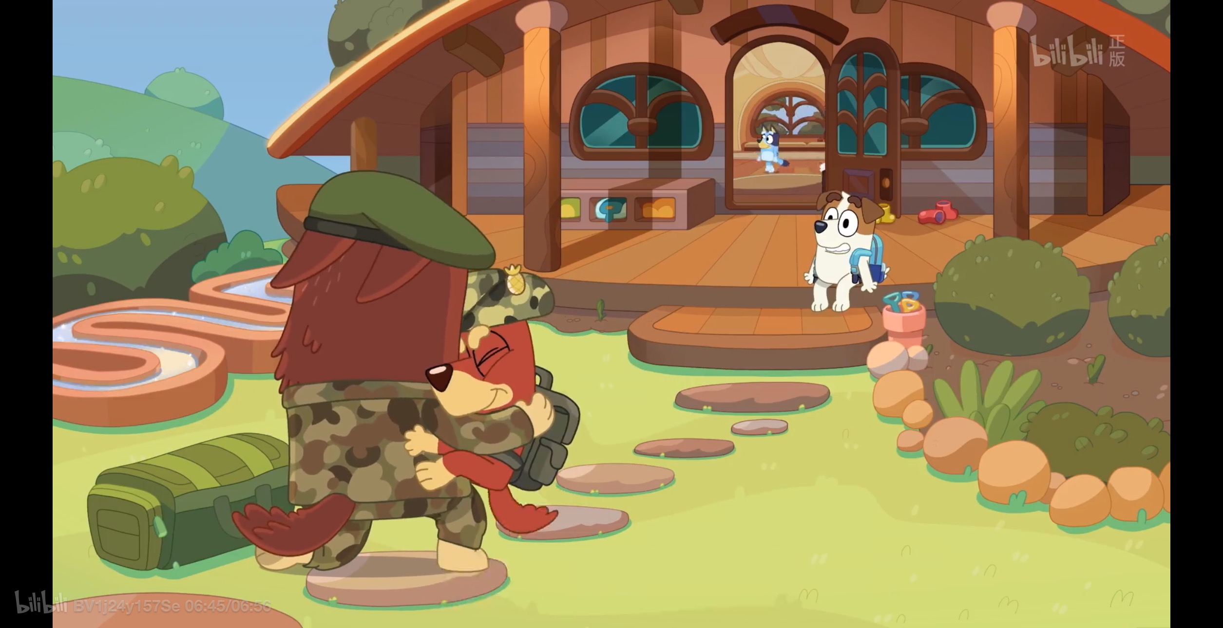
Thank you!

